Slide 1
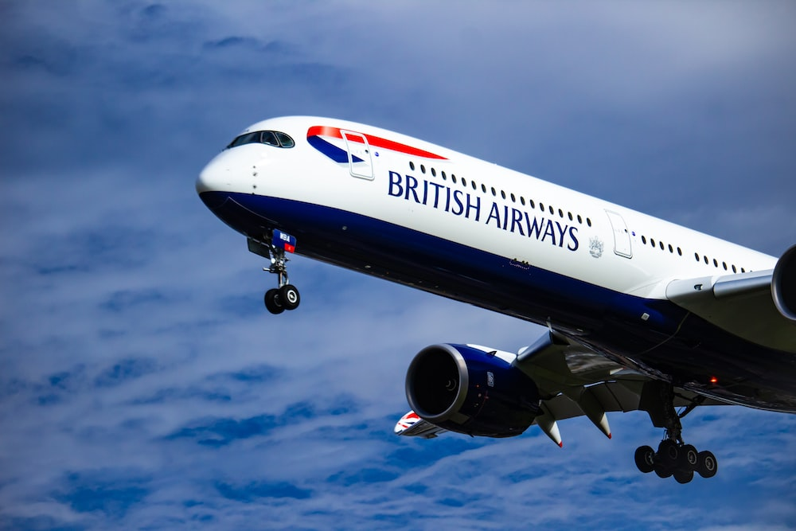
SOLELY FOR PURPOSE OF FORAGE WORK EXPERIENCE
Task 1
Web scraping to gain company insights
Scrape and analyse customer review data to uncover findings for British Airways
Kamalesh K B
19-06-2023

Slide 2
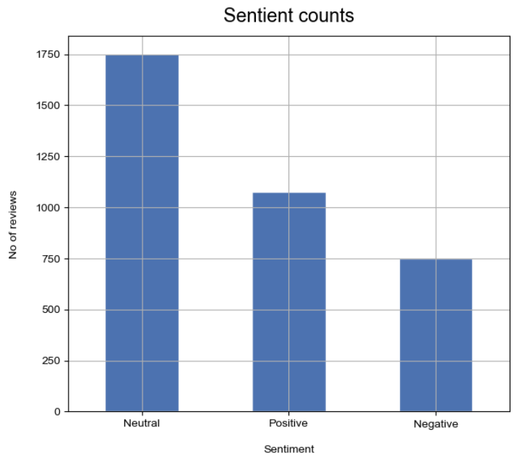
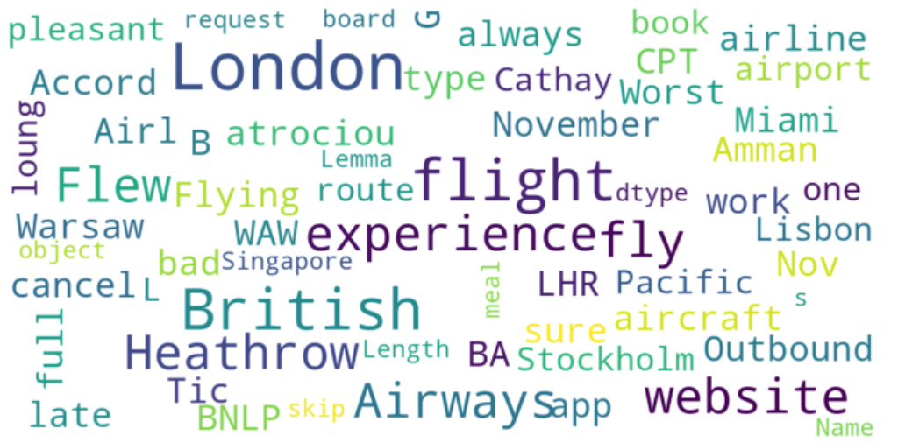
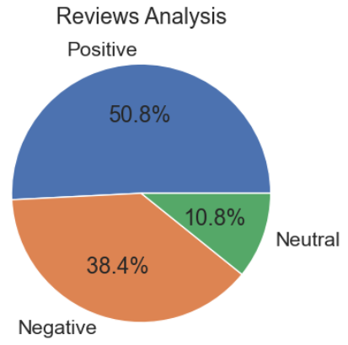
Data Collection:
Data of customer reviews of British Airways are collected by web scraping from the site Airline Equality.
Data Wrangling:
The raw & unstructured data are use to transform to structured one & make it as a excel file format.
Using of NLTK:
Then the data’s are analyzed by the Natural language toolkit NLTK
Data Visualization:
At last, The analyzed insight information from dataset where visualized using Matplotlib & Word Cloud.
Conclusion:
From analysing 3576 reviews given by the customers, we obtained:
Neutral Reviews - 1751
Positive Reviews - 1075
Negative Reviews - 750

